Slide 1

ENVIRONMENTAL MANAGEMENT SYSTEM: IMPORTANCE IN THE FOOD MANUFACTURING INDUSTRY

Slide 2
Outline
What is EMS ?
Sustainability; the basis of EMS
Importance of sustainability
EMS adoption and Food industry sustainability
Benefits of EMS in the food manufacturing industry
Conclusion
References

Slide 3
What is EMS ?
PLAN
DO
CHECK
ACT
The activities carried out by manufacturing industries, being the highest contributor of greenhouse gas, have negative impacts on the environment (Salim and Padfield, 2017).
These industries ignore the importance of sustainability as it is considered as a cost burden and limits their growth (Salim and Padfield, 2017).
Environmental management system (EMS) is a framework that helps organizations achieve their environmental goals through integration of processes, evaluation and improvement of its environmental performance e.g ISO 14001, EMAS, ISO 14005.
FIGURE 1: Environmental management system framework

Slide 4
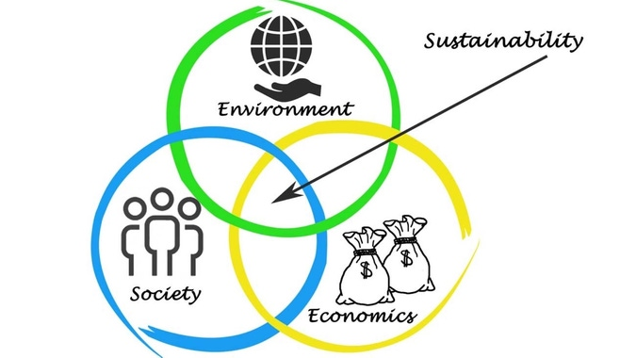
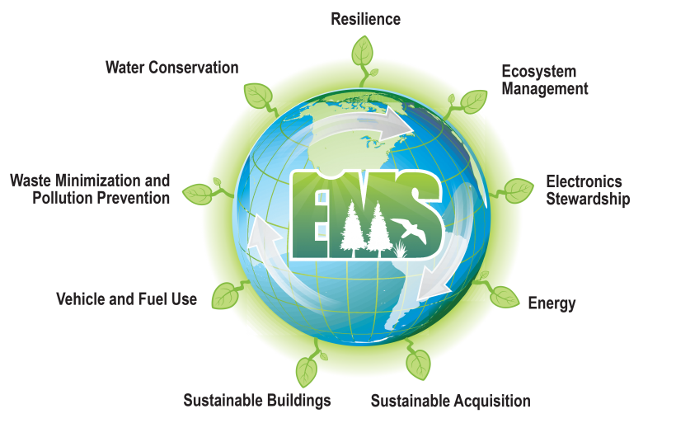
Sustainability; the basis of EMS
Sustainability is the ability to meet present needs without interfering in the ability of future generation to meet their needs, this concept is the basis of EMS.
EMS is a system that involves achieving environmental goals.
To have a sustainable environment, policies, planning, training, implementation and review systems must be put in place.
Sustainability of the environment ensures that both humans and nature co-exist productively thereby meeting the needs of the present and generations to come (Office of Legacy Management).
Figure 2: Sustainability frame work (Samiksha, 2015)
Figure 3: Environmental management system (Office of Legacy Management, no date).

Slide 5
Importance of sustainability
Importance of sustainability to organizations
Cost reduction
Waste reduction
Prevention of pollution
Improvement in competitive advantage
Increase in productivity
Improvements in stakeholder attitude
The importance of sustainability investments practices by organizations is a subject of discourse that has led to several debates (Bauer et al., 2005; Galema et al., 2008).
Organizations have immense contribution to sustainable development due to the impacts (social, environmental and economic) of their activities (Armindo et al., 2019).
However, there are several benefits for the implementation of sustainability practices by organizations (Fonseca, 2015; Henriques and Catarino, 2015; Sukitsch et al., 2015; Baumgartner and Rauter, 2017).
Figure 4: Importance of sustainability to organizations

Slide 6
EMS adoption and Food industry sustainability
Environmental risks from food industries
Food Loss
Water consumption
Pollution (Environmental Contaminants & Pollutants)
Greenhouse Gas Emissions
Depletion of Natural Resources
Food manufacturing industries produce, process and transport large amount food for consumption.
Adoption of EMS will immensely mitigate the environmental impacts of these activities hence, improvements in sustainability and business performance (Salim and Padfield, 2017).
The plan, do, check and act framework of EMS enables improvements in environmental performance of the food industry through a consistent control of operations (Massoud et al., 2010).
For instance, adoption of EMS enables the development of policies that enables practices such as recycling, eco friendly packaging, waste reduction and efficiency in the use of resources ensuring a more sustainable environment.
Figure 5: Environmental risks posed by food manufacturing industries

Slide 7
Benefits of EMS in the food manufacturing industry
BENEFITS OF EMS
Improved environmental performance
supply chain advantage
Market share increase
Improvements in investment opportunities
Reduction in insurance premium
Environmental taxes
Financial incentives
Environmental compliance
Despite the beliefs of that sustainability investment is cost intensive, the long term benefit and cost advantage overrides this thought.
The benefits of adopting EMS is not limited to achieving environmental goals but improved productivity and profitability for the organization (Salim and Padfield, 2017).
A case study of Edinborough Products Pvt. Ltd shows a significant reduction in waste (solid, water and oil) production by adopting EMS and a positive impact on environmental performance and financial indicators (Kumara and Weerasinghe, 2017).
Figure 6: Benefits of Adopting EMS

Slide 8
Conclusion
It is important for all organizations to adopt sustainable practices to achieve environmental goals.
The adoption of EMS, a system that helps to develop, plan, implement, review, check and correct policies to achieve environmental goals of the organization, improves environmental performance as well business performance in food manufacturing industries.

Slide 9
References
Armindo, J., Fonseca, A., Abreu, I Toldy, T. (2019) ‘Is the economic dimension inducing the other sustainability dimensions, or is it the reverse? Perceptions from the Portuguese metal industry’, International Journal of Sustainable Development & World Ecology, 26(7), pp 571-582.
Bauer, R., Koedijk, K., and Otten, R. (2005) ‘International evidence on ethical mutual fund performance and investment style’, Journal of Banking & Finance, 29(7), pp. 1751–1767.
Baumgartner, R.J., Rauter, R. (2017) ‘Strategic perspectives of corporate sustainability management to develop a sustainable organization’, J Clean Prod, 140, pp. 81–92.
Fonseca, L.M. (2015) ‘Strategic drivers for implementing sustainability programs in Portuguese organizations - let’s listen to Aristotle: from triple to quadruple bottom line’, Sust, 8(3), pp. 136–142.
Galema, R., Plantinga, A., and Scholtens, B. (2008) ‘The stocks at stake: Return and risk in socially responsible investment’, Journal of Banking & Finance, 32(12), pp. 2646–2654.
Gladwin, T., Kennelly, J. J., and Krause, T. (1995) ‘Shifting paradigms for sustainable development: implications for management theory and research’, Academy of Management Review, 20, pp. 874–907.

Slide 10
Henriques, J., Catarino, J. (2015) ‘Sustainable value and cleaner production - research and application in 19 Portuguese SME’, J Clean Prod, 96, pp. 379–386.
Kumara, K. and Weerasinghe, T. (2017) ‘The Effectiveness of Implementing Environmental Management System - ISO 14001 in Food Manufacturing Companies: A Case Study of a Sri Lankan Food Manufacturing Company’, Environmental Management and Sustainable Development, 6 (2), pp. 240-249.
Massoud, M. A., Fayad, R., El-Fadel, M., Kamleh, R. (2010), ‘Drivers, barriers and incentives to implementing environmental management systems in the food industry: a case of Lebanon’, Journal of Cleaner Production, 18(3), pp. 200-209.
Office of Legacy Management (no date). Environmental Sustainability. Available at: https://www.energy.gov/lm/listings/environmental-sustainability (Accessed: 12 February 2022)
Salim H.K., and Padfield R. (2017) ‘Environmental management system in the food and beverage sector: a case study from malaysia’, Chemical Engineering Transactions, 56, pp. 253-258 DOI:10.3303/CET1756043.
Samiksha J. (2015) 6 effective ways to build a sustainable business. Available at: https://www.entrepreneur.com/article/252029 (Accessed: 12 February 2022)
Sukitsch, M., Engert, S., Baumgartner, R.J. (2015) ‘The implementation of corporate sustainability in the european automotive industry: an analysis of sustainability reports’, Sustain, 7, pp. 11504–11531.

